Slide 1
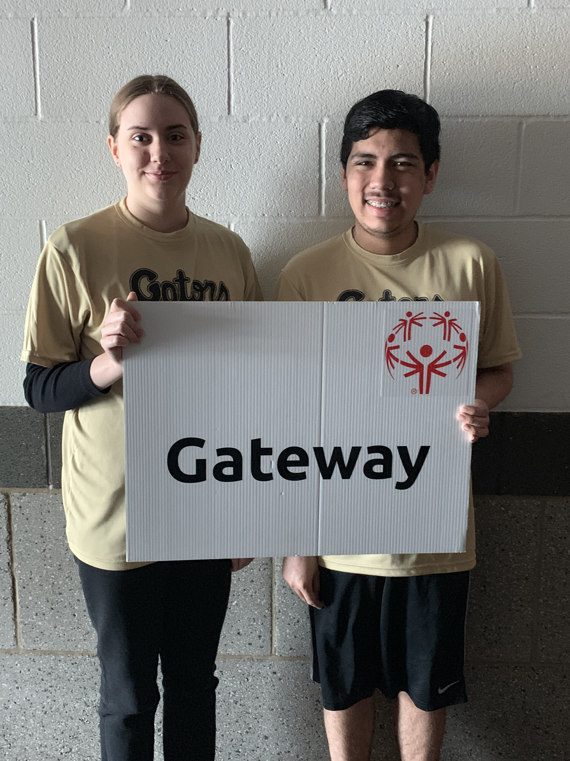

Slide 2
Highlights of SOAC
Gateway High School athletes participated in 13 events earning 17 gold metals, 16 silver metals and 5 bronze metals.
Special Olympics gave Gateway High School the opportunity to see students in a different light – as ATHLETES!
The athletes were engaged and motivated throughout the day by each other, volunteers and teachers.
Moments like these are not always experienced in the classroom.
The skills the students learned through SOAC are invaluable and transferable!

Slide 3
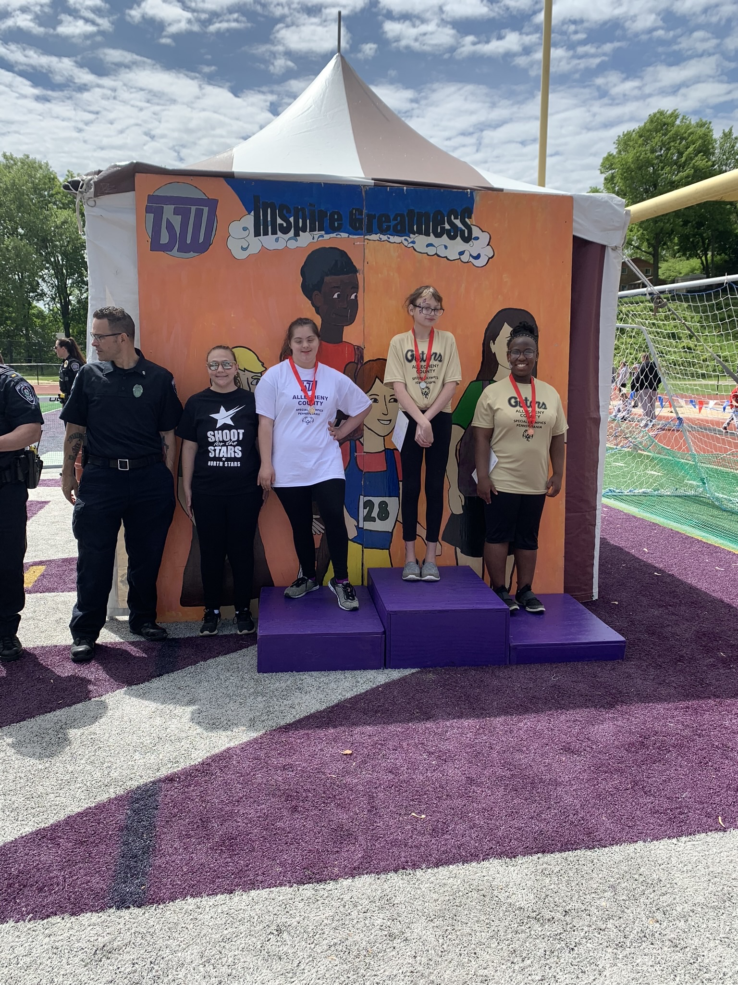
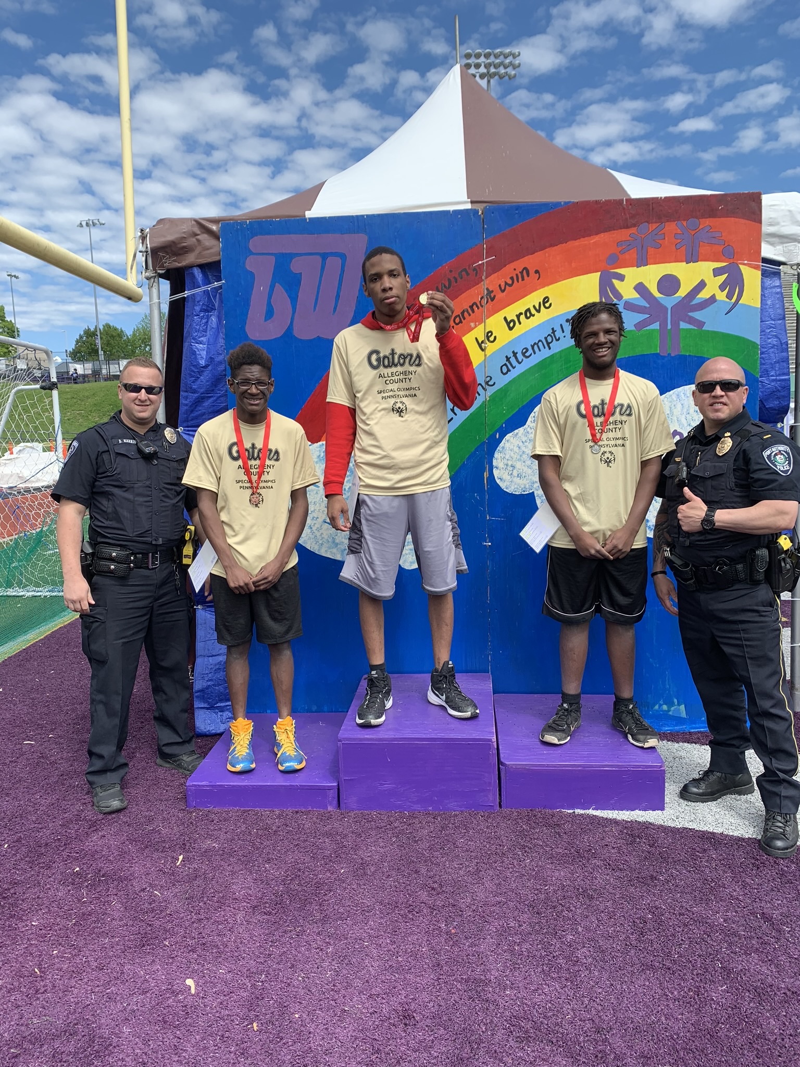
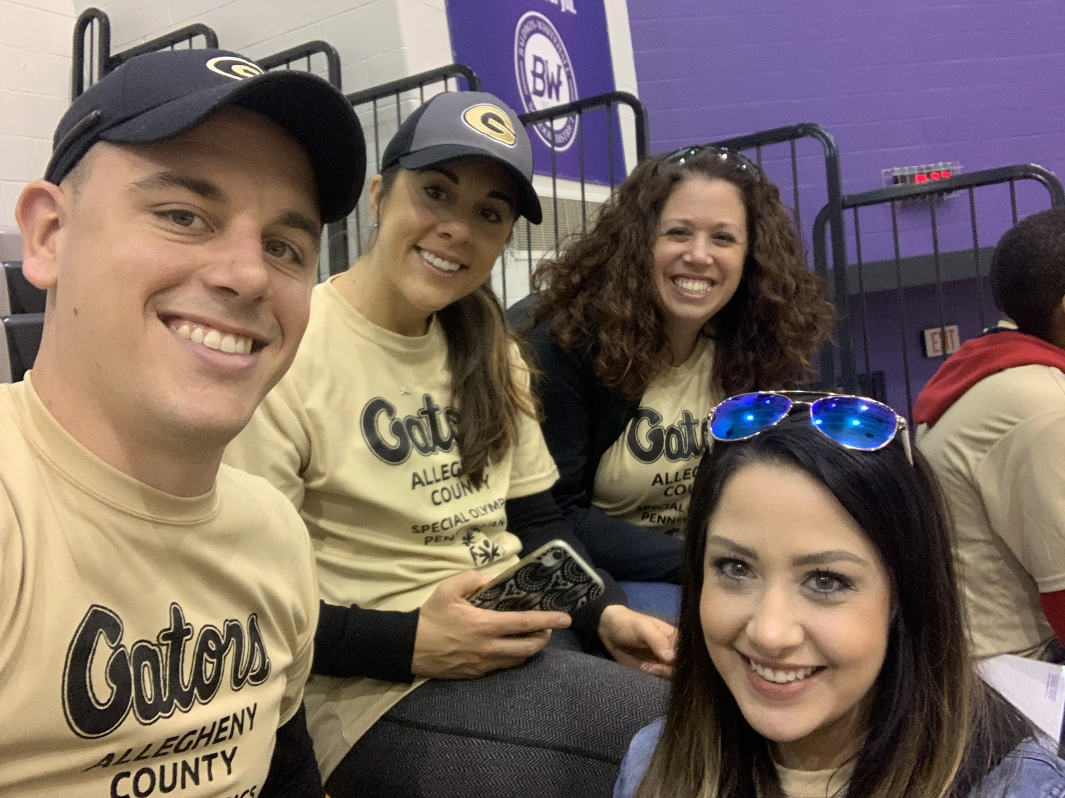
Athletes
Teachers
Damor Alston (1 gold, 3 silver)
Daylen Alston (2 gold, 1 silver, 1 bronze)
Jesus Bernal (2 gold, 1 silver, 1 bronze)
Mercedes Adipotti (1 gold, 2 silver)
Gagan Makkar (2 gold, 2 silver)
Damanpreet Singh (2 gold, 1 silver, 1 bronze)
Raymond Rowe (3 gold, 1 silver)
Alyssa Fritz (1 gold, 3 silver)
Zoe Whitman (2 gold, 1 silver)
Pauline White (1 gold, 1 silver, 2 bronze)
Kara Samsa – Autistic Support/Life Skills Teacher
Brooke Ruby – Autistic Support Teacher
Andrew Estok – Life Skills Teacher
Megan Petruska – Transition Coordinator

Slide 4
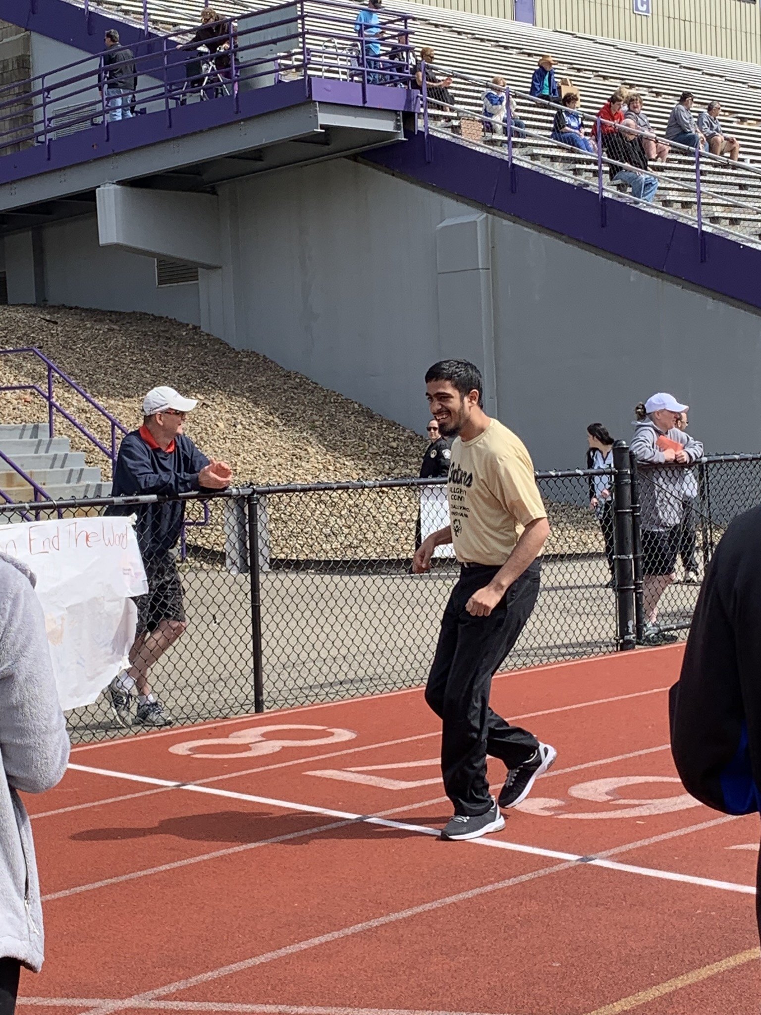
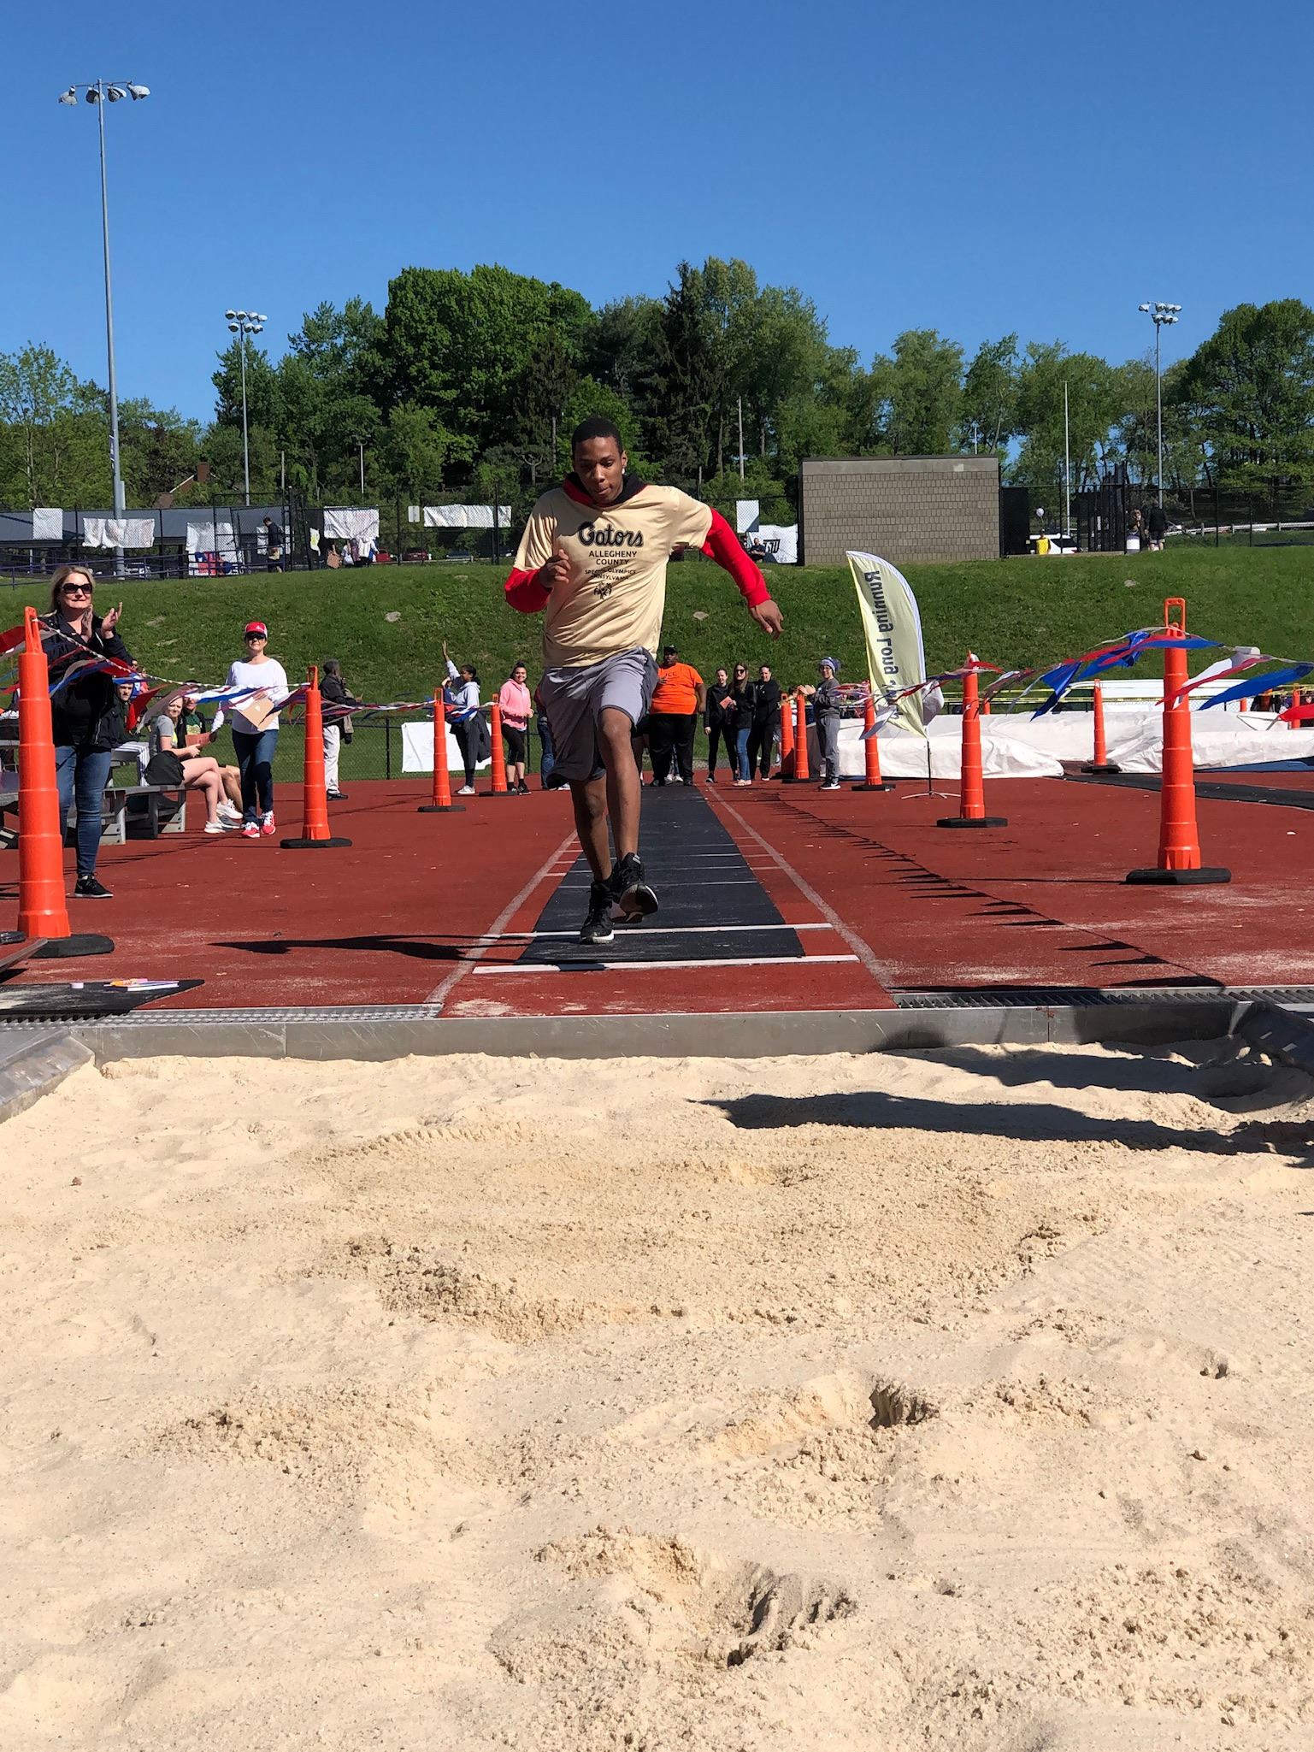
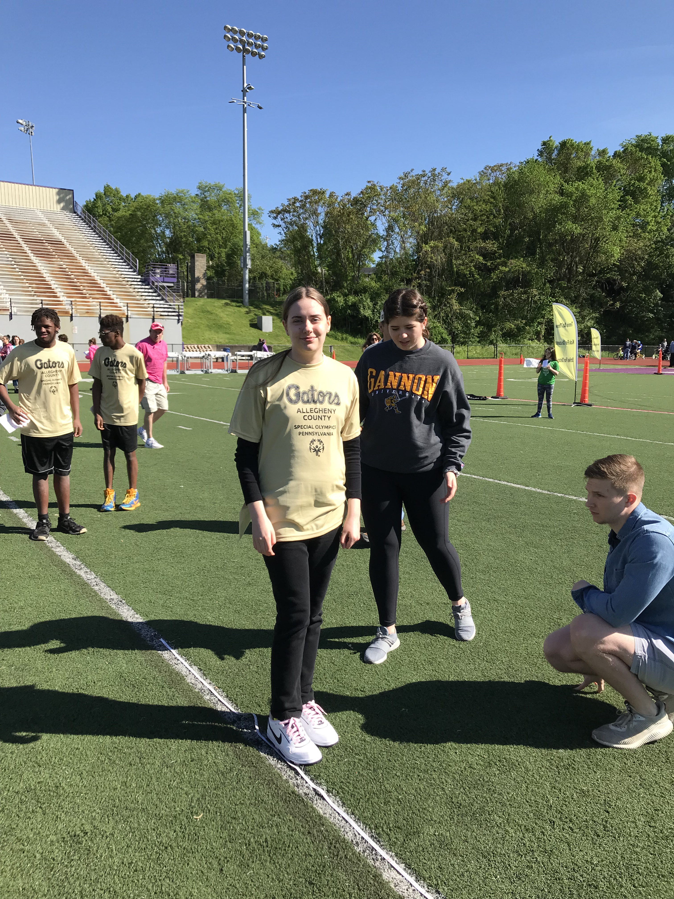
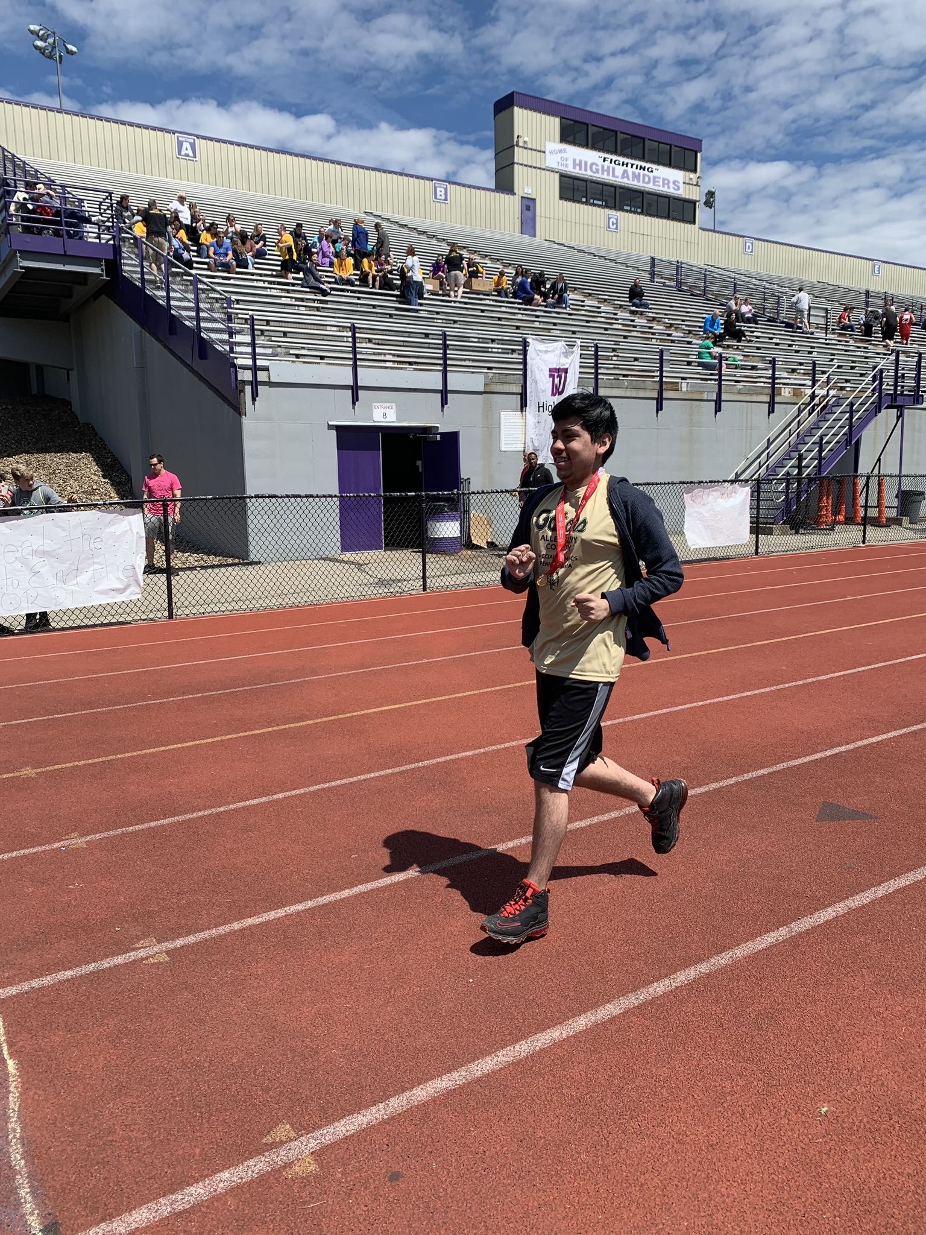
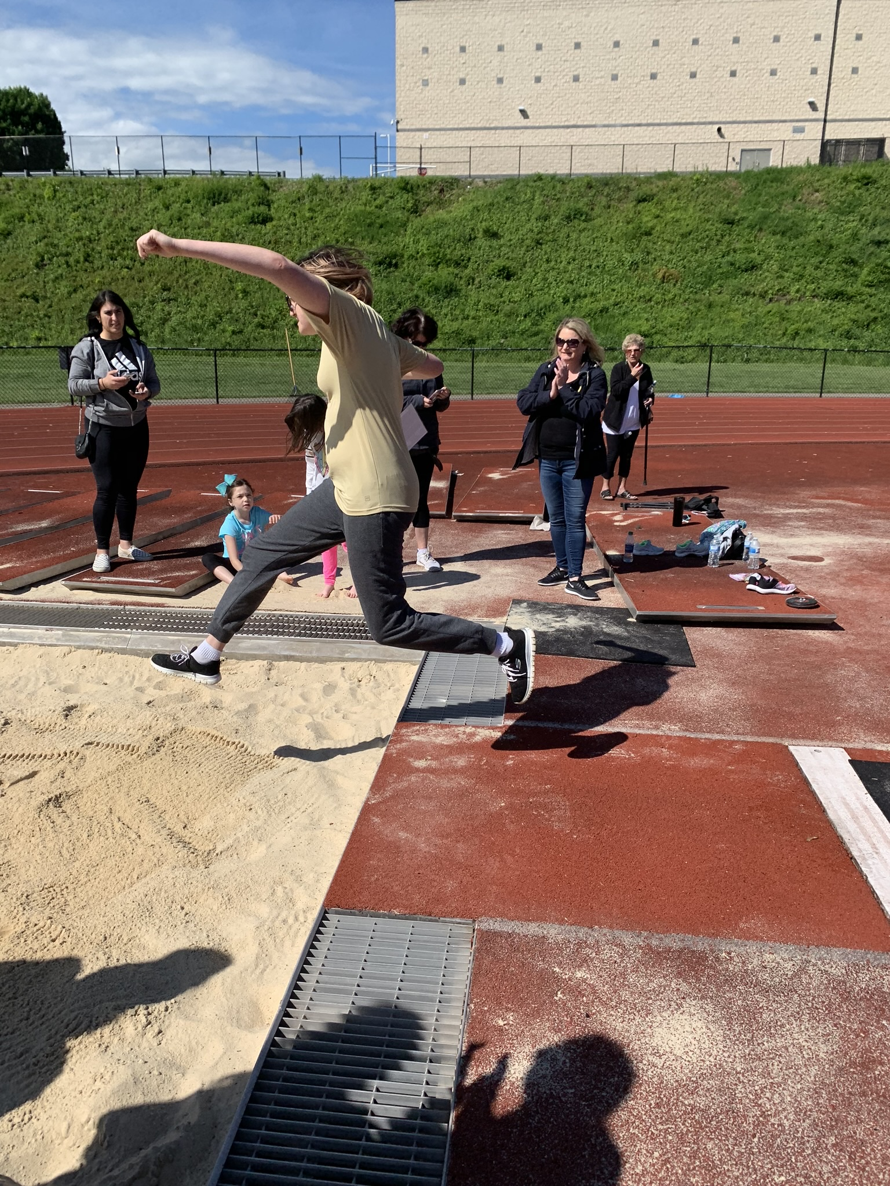
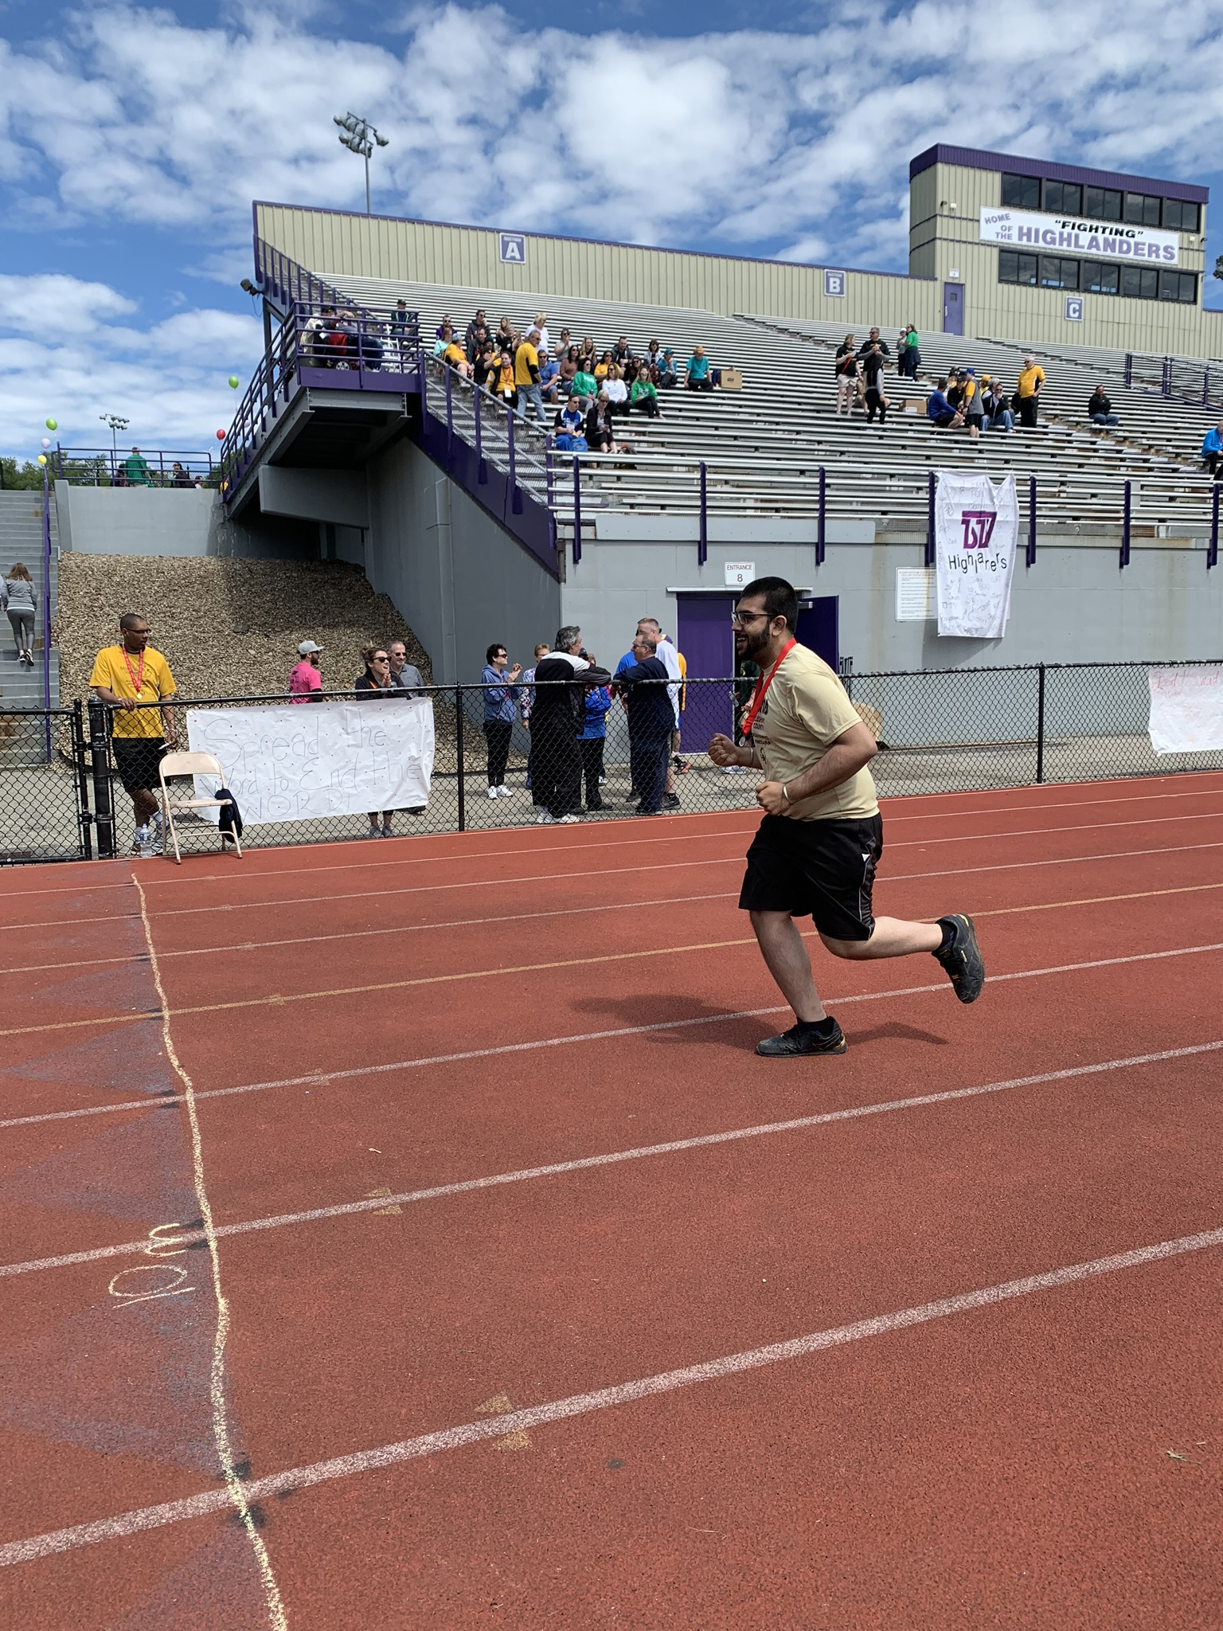
Events:
10 M Walk
50 M Walk
50 M Dash
100 M Walk
100 M Dash
400 M Walk
400 M Dash
Softball Throw
Tennis Ball Throw
Strike for Distance
Kick for Distance
Standing Long Jump
Running Long Jump

Slide 5
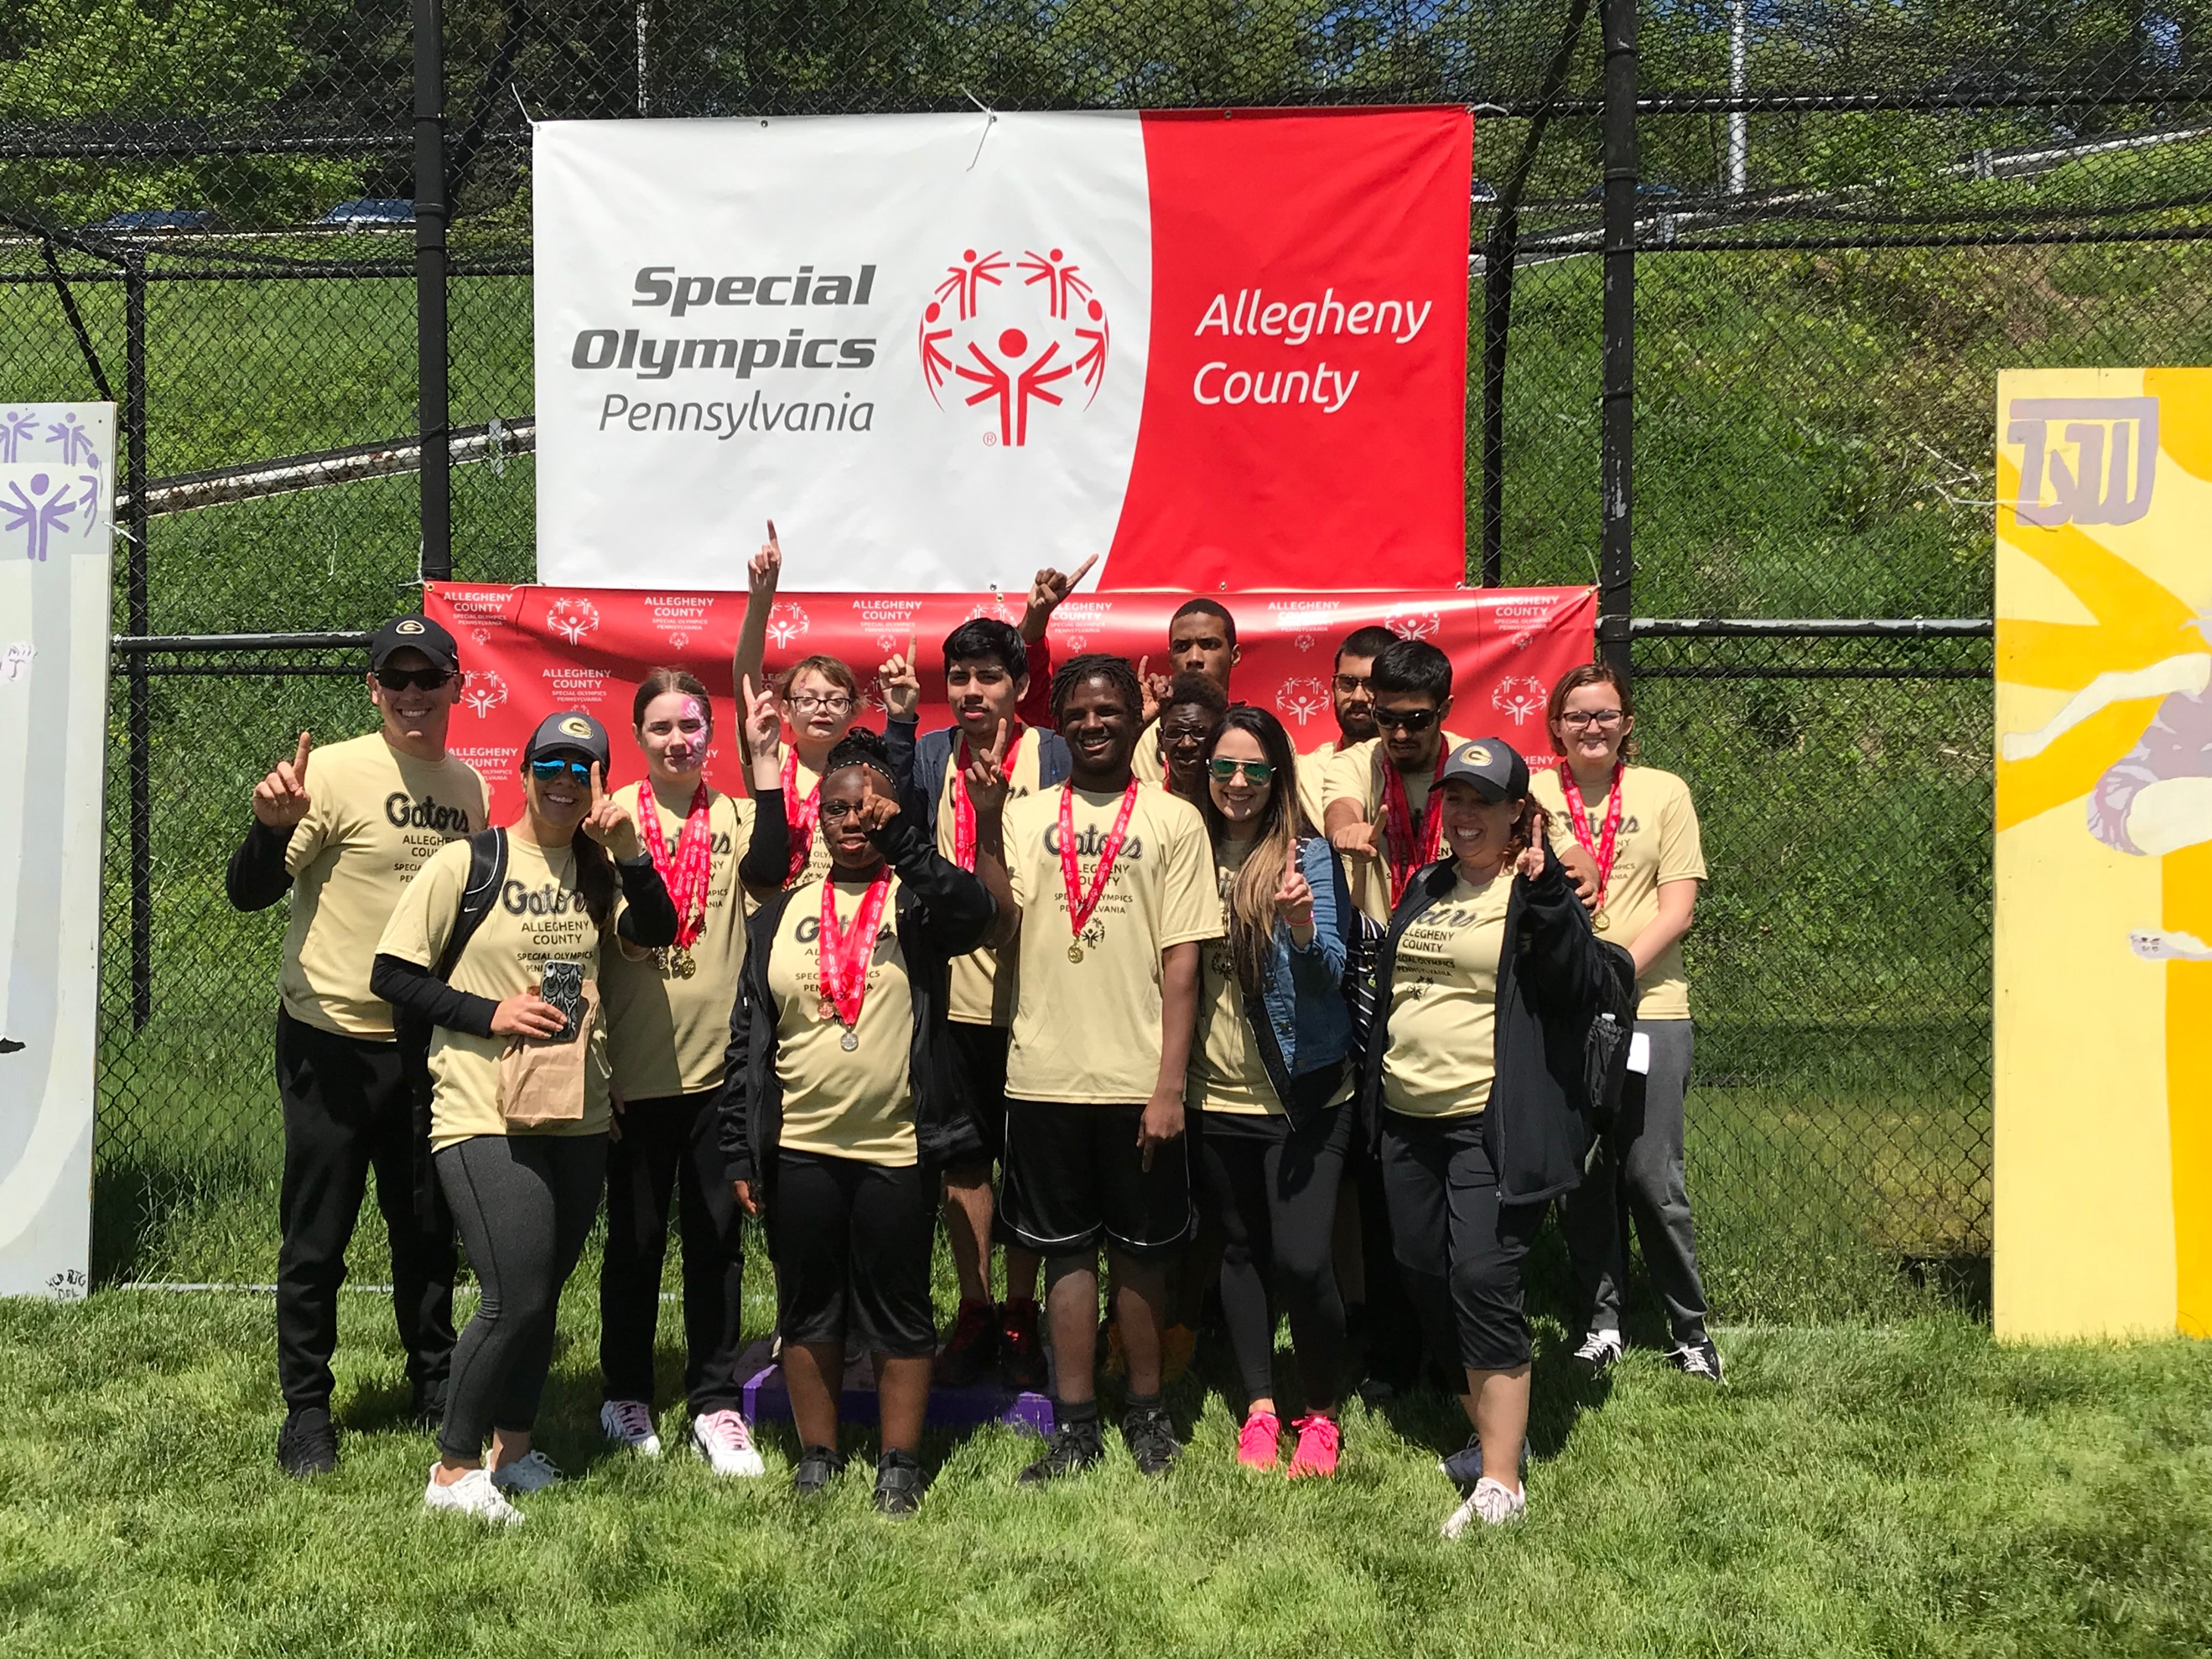
NOONE beats a GATOR!
“Some athletes shatter world records, others shatter perceptions”

